Slide 1

A Hands-on Introduction to Machine Learning
9. Neural Networks

Slide 2
Artificial neural networks
Information processing paradigm inspired by the way biological nervous systems (e.g., brains) process information
A crude software equivalent of the neuronal structure of our brains
Composed of many highly interconnected processing elements (neurons) working in unison to solve specific problems

Slide 3
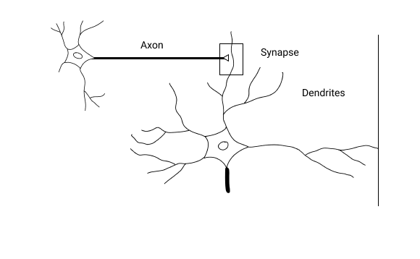
Human neuron

Slide 4
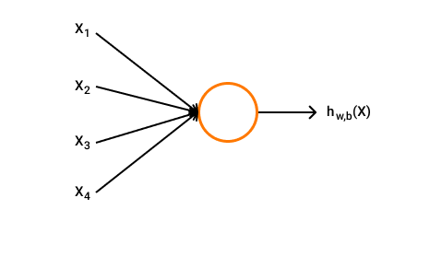
Artificial neuron

Slide 5
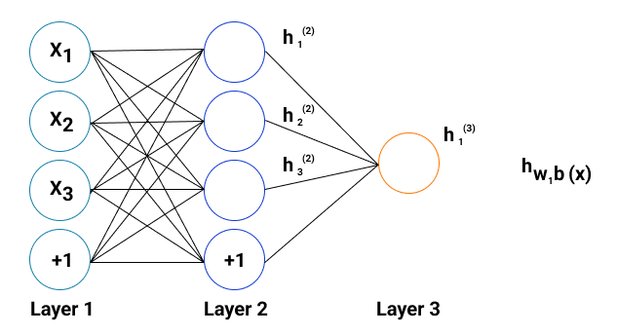
Neural network

Slide 6
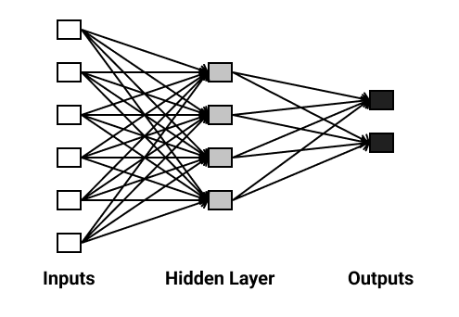
Feedforward neural network

Slide 7
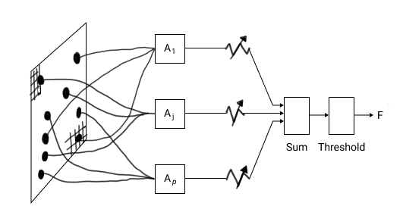
Perceptron model of neuron

Slide 8
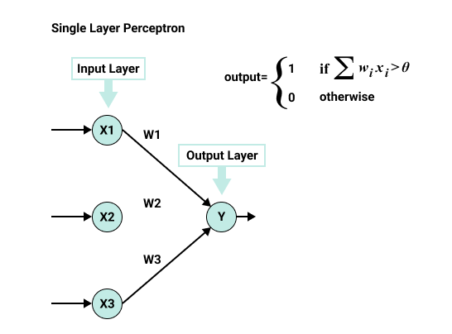
Single layer perceptron network

Slide 9
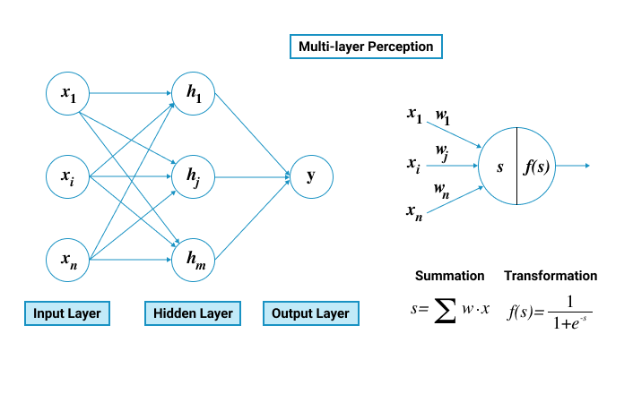
Multilayer perceptron network

Slide 10
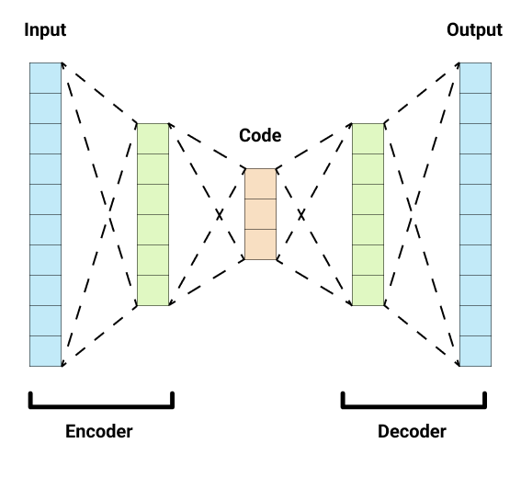
Autoencoders

Slide 11
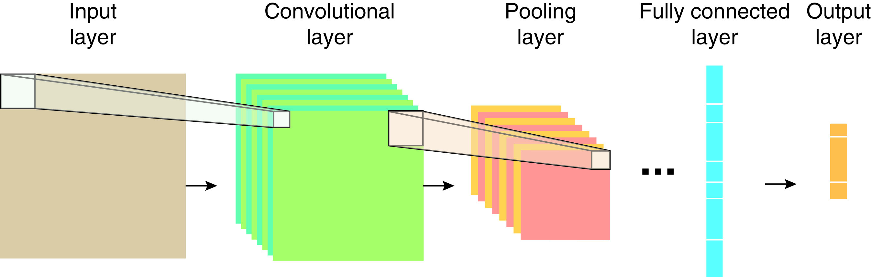
Convolution Neural Network (CNN)

Slide 12
Recurrent Neural Network (RNN)
CNN lacks memory that we need to process a sequential data like a sentence
RNN is a neural network with a self-loop in its hidden layer
A series of networks that are run over and over again with timed inputs
RNN does the same task repeatedly, with the output dependent on the previous step in a given time
This allows for what we learn from one pass to influence the next pass

Slide 13
Long Short Term Memory (LSTM)
Two big problems with RNN: vanishing gradient and exploding gradient
LSTM contains feedback connections, allowing it to process an entire sequence of data, such as a time series, rather than treating each of the data points in that sequence separately
This allows LSTM to consider the bigger context (long term memory) while producing the output using the previous input (short term memory)
LSTM uses a set of gates that control how input comes in, how it gets stored, and how it leaves the network
Three types of gates: input gates, output gates, forget gates

Slide 14
Summary
Neural networks provide a way to solve non-linear problems, in methods inspired by how we believe our brain works.
Recent advancements in computation and storage as well as availability of massive amounts of data for training have made neural networks attractive and effective for many types of ML problems.
Notable examples of neural network architectures:
Perceptrons (single layer and multi-layer)
Autoencoders
Convolutional neural network (CNN)
Recurrent neural network (RNN)
Long Short Term Memory (LSTM)

